Slide 1
Literary Elements
RL.12.3

Slide 2
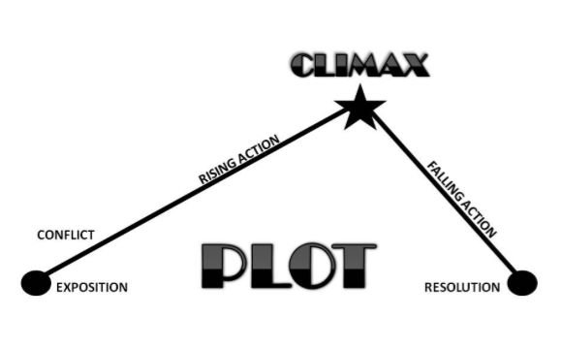
Plot
A series of related events that present and resolve a conflict.
Develops over the course of the story.

Slide 3
Exposition rising action
Exposition
The part of the story, usually near the beginning, in which the characters are introduced, the background is explained, and the setting is described.
Rising Action
The central part of the story during which various problems arise after a conflict is introduced.

Slide 4
Climax, falling action, & Resolution
Climax
The most exciting point in the story - conflict is decided.
Falling Action
The action and dialogue following the climax that lead the reader into the story’s end.
Resolution
The conflict is resolved (positively or negatively) and the story is brought to a close.

Slide 5
Characterization
Characterization is the technique used by the author to create / reveal the personalities of the characters in the work. This could be done by:
Direct Characterization: the author directly states aspects of the character’s personality
Indirect Characterization: More common method. We must infer personality traits from the story.
Protagonist
MAIN CHARACTER of the story (often the hero or who the audience is supposed to feel the most sympathy / closely tied to).
Antagonist
Primary adversary of the protagonist
Sometimes the villain.

Slide 6
Indirect characterization
Could be determined through:
Describing physical appearances or situation
Revealing a character’s thoughts
A character’s words or actions
Showing the reactions of other characters

Slide 7
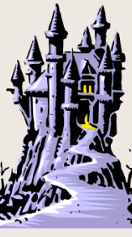
setting
The time and place in which the action of the narrative takes place.

Slide 8
Sequencing
Refers to the order of the events that happen in the story – the beginning, middle, and end – and also the ability to retell the events within a given text in the order in which they occurred.
The ability to sequence events in a text is a key comprehension strategy, especially for narrative texts.

Slide 9
Diction / syntax
DICTION:
Style of speaking or writing, determined by the choice of words by a speaker, writer, or character.
The audience will determine the diction.
SYNTAX:
Refers to the actual way in which words and sentences are placed together in writing.

Slide 10
Irony
IRONY:
The differences in appearance and reality, or expectations and results, or meaning and intention.
Dramatic Irony:
A contradiction between what a character thinks and what the reader or audience knows to be true.
Situational Irony:
An event occurs that directly contradicts the expectations of the characters, readers, or audience.
Verbal Irony:
Words are used to suggest the opposite of what is meant (i.e. sarcasm, double-meaning, etc.)

Slide 11
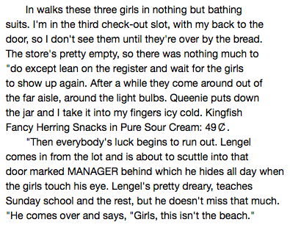
I Do:
1. Identify the setting in John Updike’s “A&P”:
A. A city pool
B. A department store
C. A grocery store
D. A hardware store
2. Who is presented as the antagonist in the story?
A. The three girls
B. Queenie
C. Lengel
D. Sammy

Slide 12
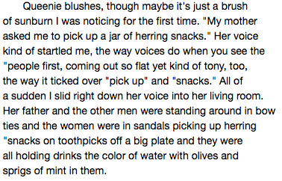

Slide 13
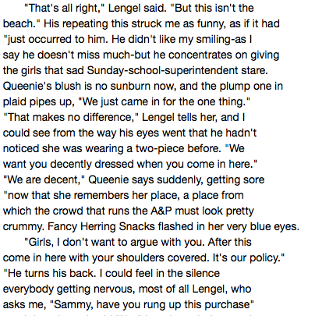
We do:
1. Identify the sequencing of events thus far:
2. What appears to be the problem in the story?
3. What would be considered the rising action in the story?

Slide 14
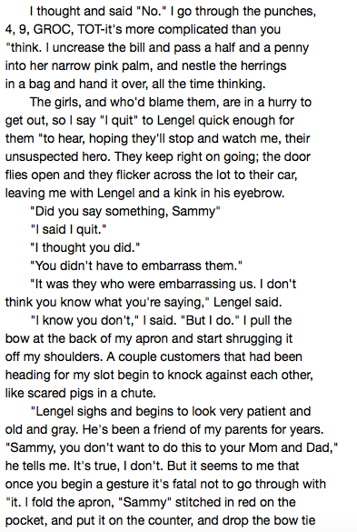
We do:

Slide 15
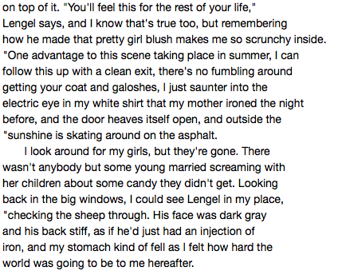
You Do:
1. Describe relationships between the characters: (Sammy, Lengel, the three girls).
2. What is the climax of the story?
3. Describe any irony found in the story.

